Slide 1
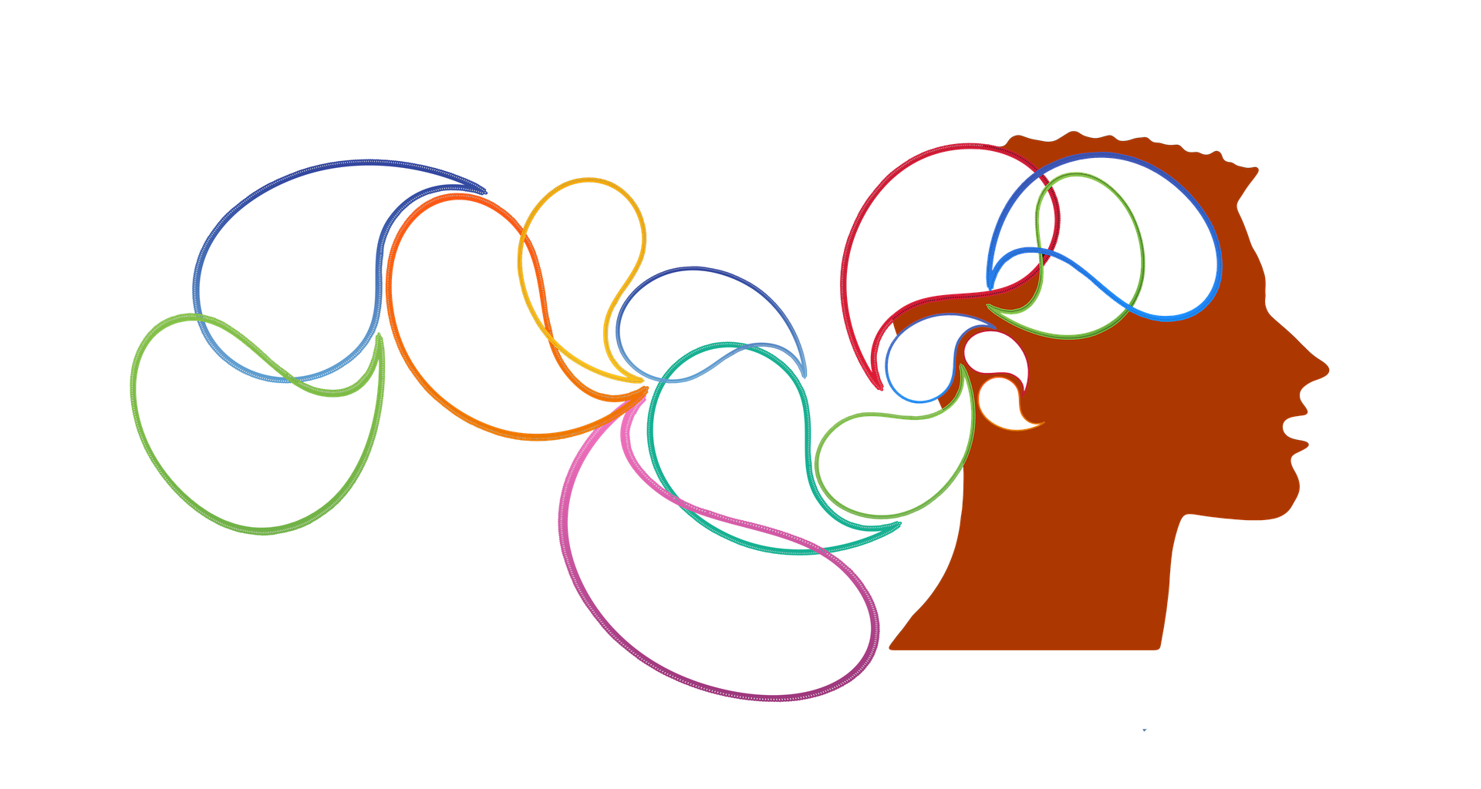



Decoding Individual and Shared Experiences of Media Perception using CNN architectures
Riddhi Johri, IIT Gandhinagar
Pankaj Pandey, IIT Gandhinagar
Krishna Prasad Miyapuram, IIT Gandhinagar
James Derek Lomas, TU Delft
1
This Photo by Unknown author is licensed under CC BY.

Slide 2
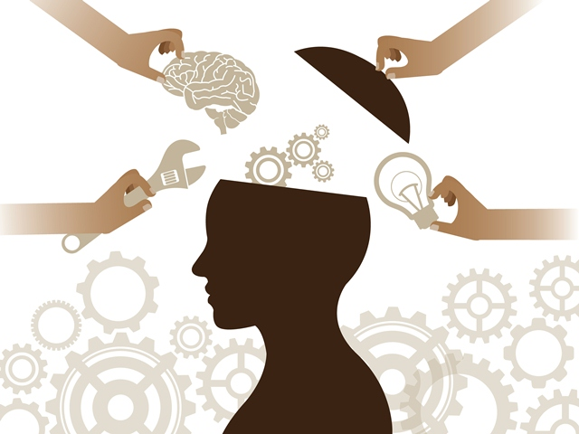
Outline
Introduction
Problem Motivation
Related Studies
Media Stimulus Datasets
Classification Methodology
Experimental Results
Discussion and Conclusion

Slide 3
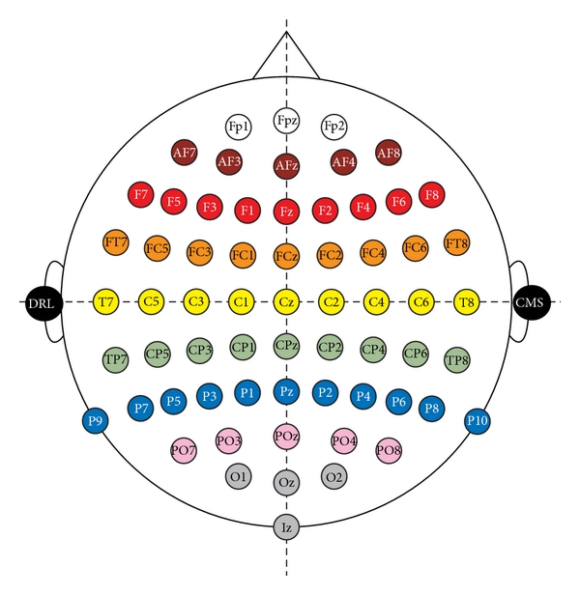
Introduction
EEG measures synchronized neuronal activity in the brain's cortical region
EEG signals are commonly used in neuroscience research to study various aspects of brain function.
They are also used in clinical settings to diagnose and monitor medical conditions.
Different machine learning models can be used to capture features of a specific activity or disorder.
The EEG signals are recorded using the internationally accepted 10-20 system for placing scalp electrodes.
Fig 1: EEG Electrode placement on the scalp

Slide 4
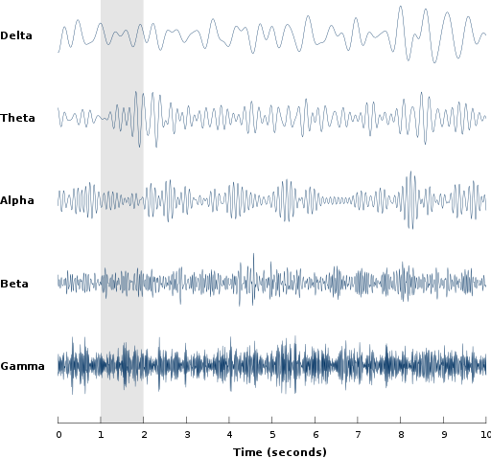
Fig 2: The five frequency bands of brainwaves observed in EEG signals

Slide 5
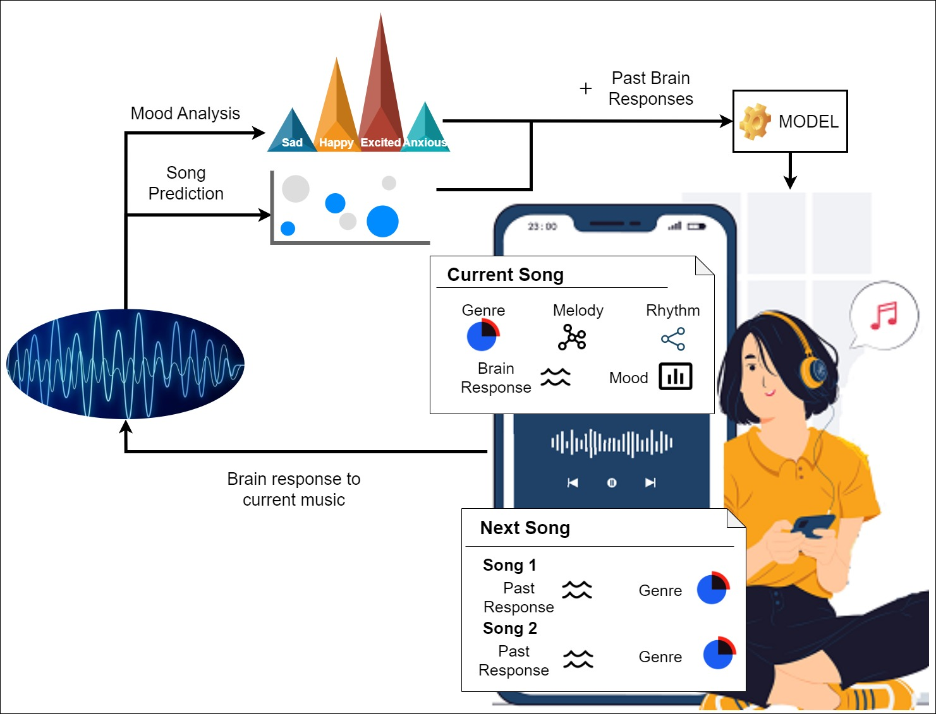
Motivation
Correctly elucidate the brain waves using neural architectures
Evaluate Individual and Shared experiences in two different settings:
Song Classification
Movie Classification
Analyze the type and extent of feature learning done by deep learning networks.
Fig 3: Media Experience Brain Space

Slide 6

Related Studies
Media experience can be regulated using the user’s brainwaves by detecting the person’s concentration and excitement levels.
EEG headsets are being enhanced and developed for wearable consumer applications, understanding and predicting people’s responses to different media experiences, emotion prediction and practicing meditation.
Song recommendation systems utilize collaborative filtering and content-based filtering techniques.
EEG-based song identification shows promise in creating personalized playlist recommendations and enhancing song retrieval systems.
The uniqueness of individual brain patterns in response to music presents difficulties in achieving generalization in EEG learning.
Specific power band spectra (beta and gamma) and the first 20 seconds of a song segment can be used for accurate song classification.
CNN architectures exhibit strong performance in within-participant song prediction, but struggle with cross-participant prediction.

Slide 7


Media Stimulus Datasets
Music - NMED-T
Stanford research Naturalistic Music EEG Dataset – Tempo (NMED-T)
Music - NMED-H
EEG was recorded with 125 channels EEG cap from 20 adult participants who each heard a set of 10 full-length songs with electronically produced beats at various tempos.
The data contains cortical and behavioral data collected during natural music listening.
EEG responses recorded with 125 channels EEG cap from 48 adults listening to full-length Hindi pop song.
Stanford research Naturalistic Music EEG Dataset - Hindi (NMED-H)
Sixteen stimuli were included in the experiment: Four songs in four conditions per song.
7

Slide 8

Media Stimulus Datasets
Movie - SEED
The SJTU Emotion EEG Dataset (SEED) contains brain response collected from fifteen subjects, seven males and eight females.
The data was collected using 62 electrode EEG cap.
The subjects watched fifteen approximately four minutes excerpts from Chinese films that evoked and maximized three emotions: positive, negative, and neutral.
Losorelli, S., Nguyen, D. T. T., Dmochowski, J. P. & Kaneshiro, B. Naturalistic music EEG dataset - tempo (NMED-T) 2017
Kaneshiro, B., Nguyen, D. T., Dmochowski, J. P., Norcia, A. M. & Berger, J. Naturalistic music EEG dataset - hindi (NMED-H) 2014-2016
Duan, R.-N., Zhu, J.-Y. & Lu, B.-L. Differential entropy feature for EEG-based emotion classification in 6th International IEEE/EMBS Conference on Neural Engineering (NER) (2013), 81–84
4 Zheng, W.-L. & Lu, B.-L. Investigating Critical Frequency Bands and Channels for EEG-based Emotion Recognition with Deep Neural Networks. IEEE Transactions on Autonomous Mental Development 7, (2015)
8

Slide 9
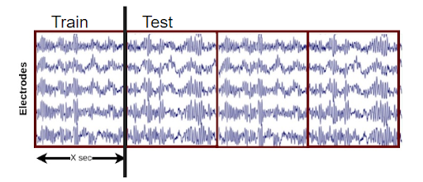
Fig 4: Sliding Time Window.
Classification Methodology
The EEG data is divided into "X" seconds time segments using the sliding window technique.
These windows are then divided into training and testing dataset to be sent to the deep learning models.

Slide 10




Individual Experience:
Within – subject or Personalized Model
Shared Experience:
Cross– subject or Generalized Model
Train
Test
Train
Test
Model Type

Slide 11
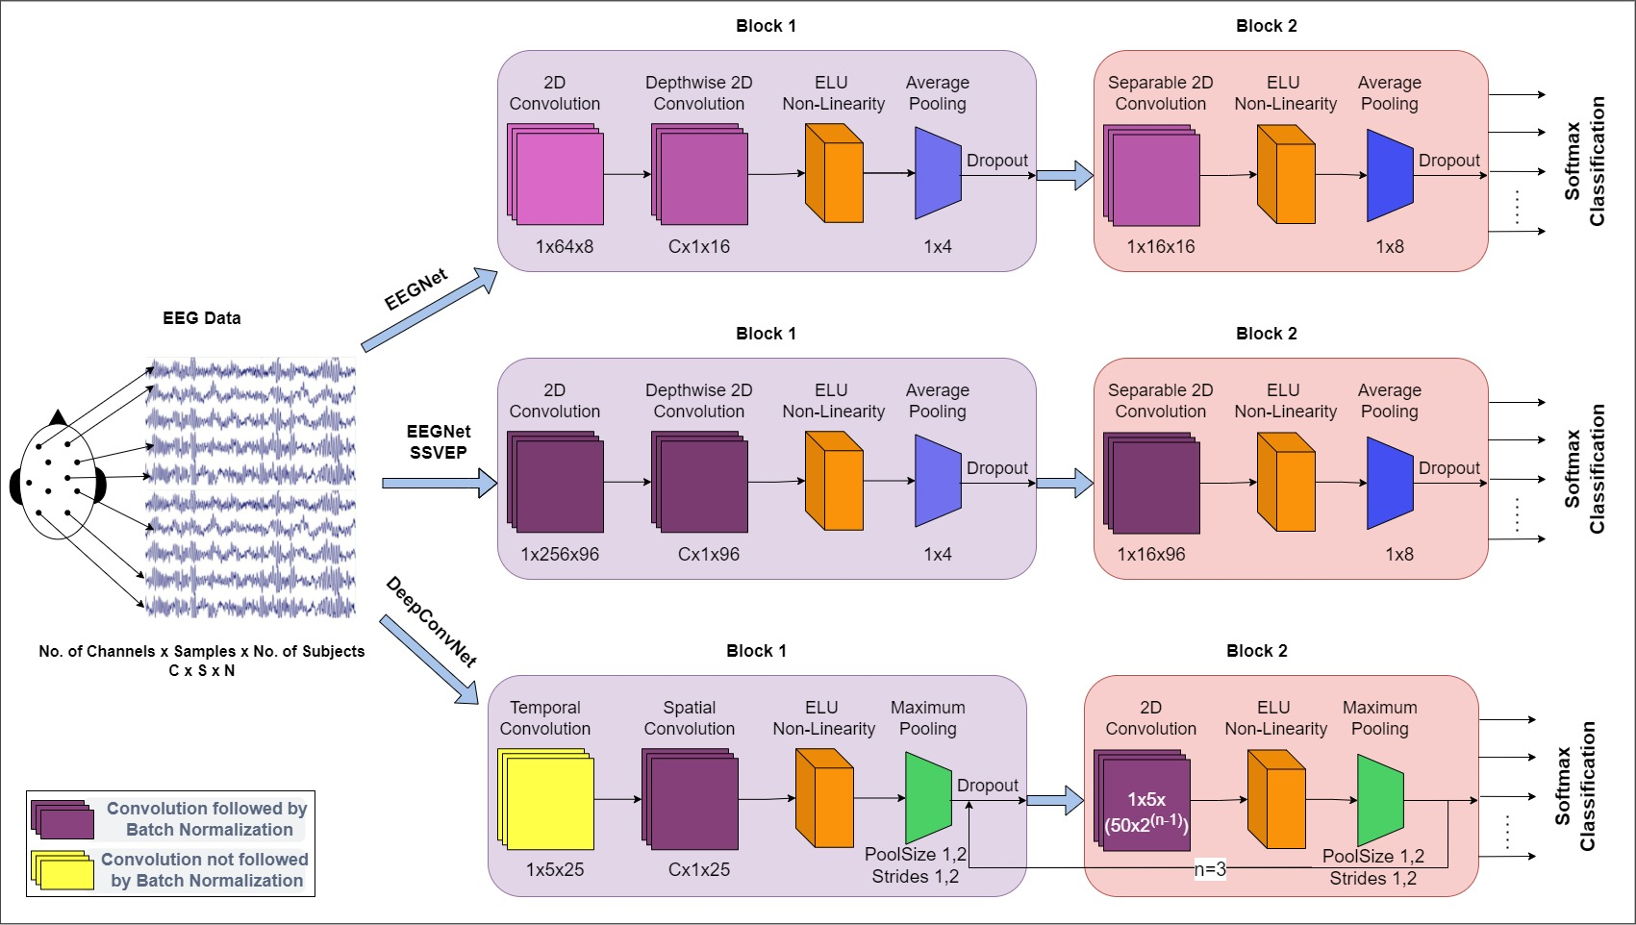
Classification Methodology
Fig 5: The different CNN architectures used for EEG data classification.
Lawhern, V. J. et al. EEGNet: a compact convolutional neural network for EEG-based brain–computer interfaces. Journal of Neural Engineering 15, 056013
Waytowich, N. et al. Compact convolutional neural networks for classification of asynchronous steady-state visual evoked potentials. Journal of Neural Engineering 15, 066031
Tibor, S. R. et al. Deep learning with convolutional neural networks for EEG decoding andvisualization. Human Brain Mapping 38, 5391–5420

Slide 12

Experimental Results of Decoding Media Perception

Slide 13
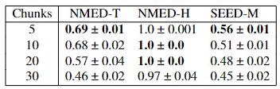
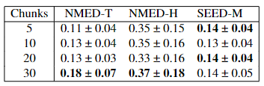
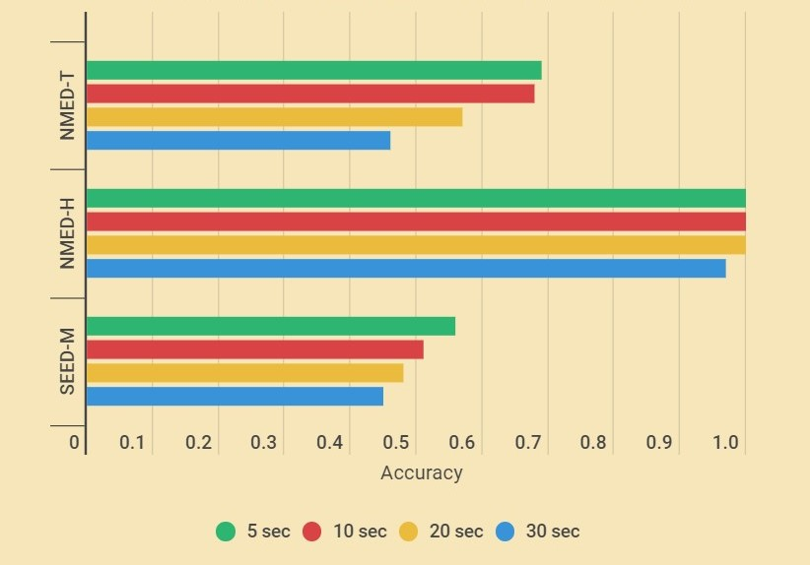
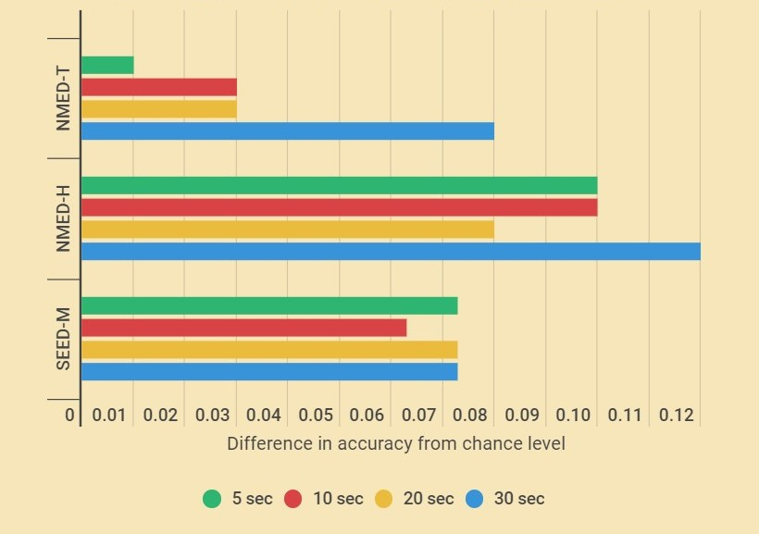
Table 1: Accuracy for within subject classification
Table 2: Accuracy for cross subject classification
Fig 6: a) Within-Subject & b) Cross-Subject Classification accuracies using different architectures on different sized time windows
Most efficient Time-window for Generalized and Personalized Model

Slide 14
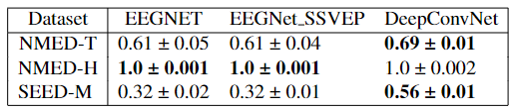
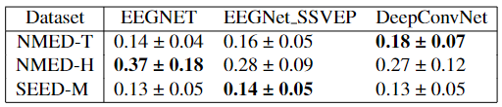
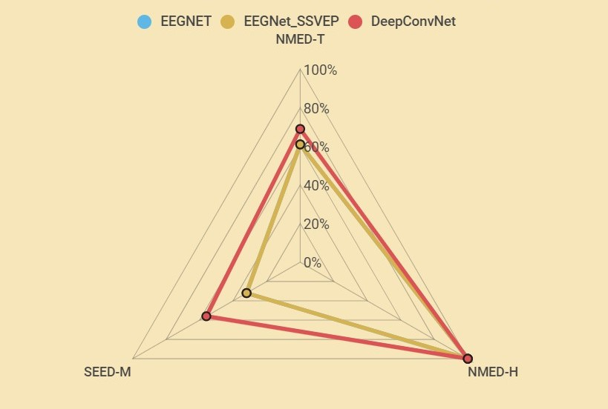
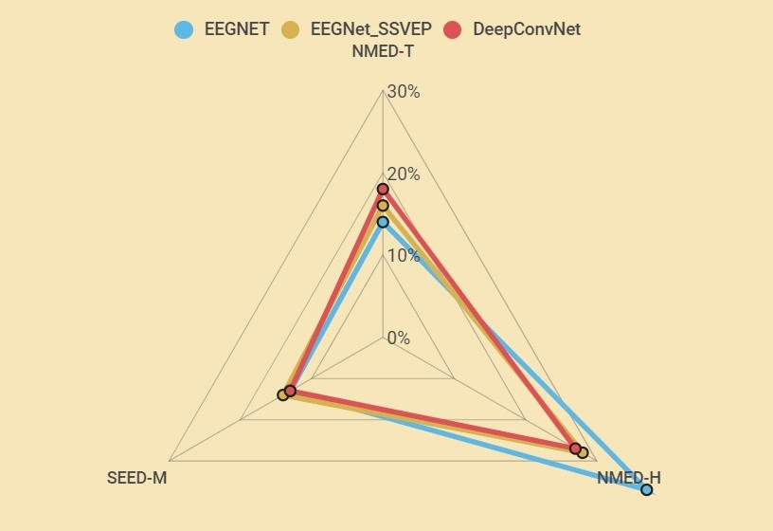
Table 3: Best within-subject accuracies achieved for each dataset
Table 4: Best cross-subject accuracies achieved for each dataset
Fig 7: Best a) Within-Subject and b) Cross-Subject Classification accuracies using different architectures on the datasets
Within-subject and Cross-subject evaluation

Slide 15
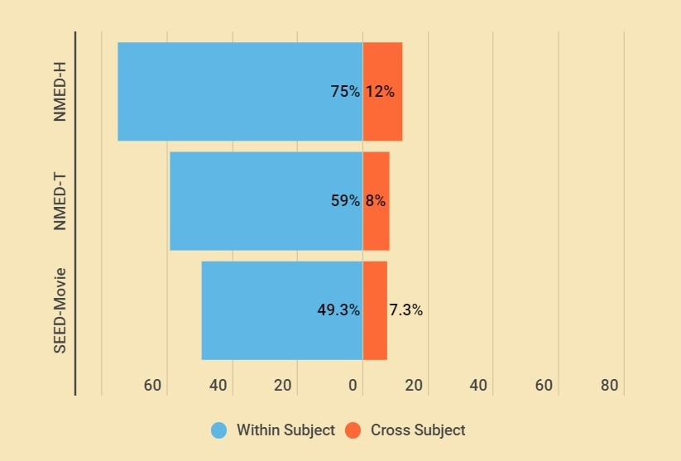
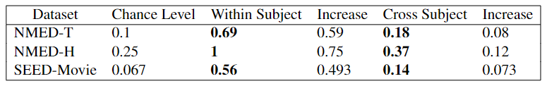
Table 5: Maximum classification accuracies achieved in the datasets considering all the architectures and various chunk sizes
Fig 8: The maximum increase in accuracy achieved from chance level on the datasets
Improvement from Chance Level

Slide 16
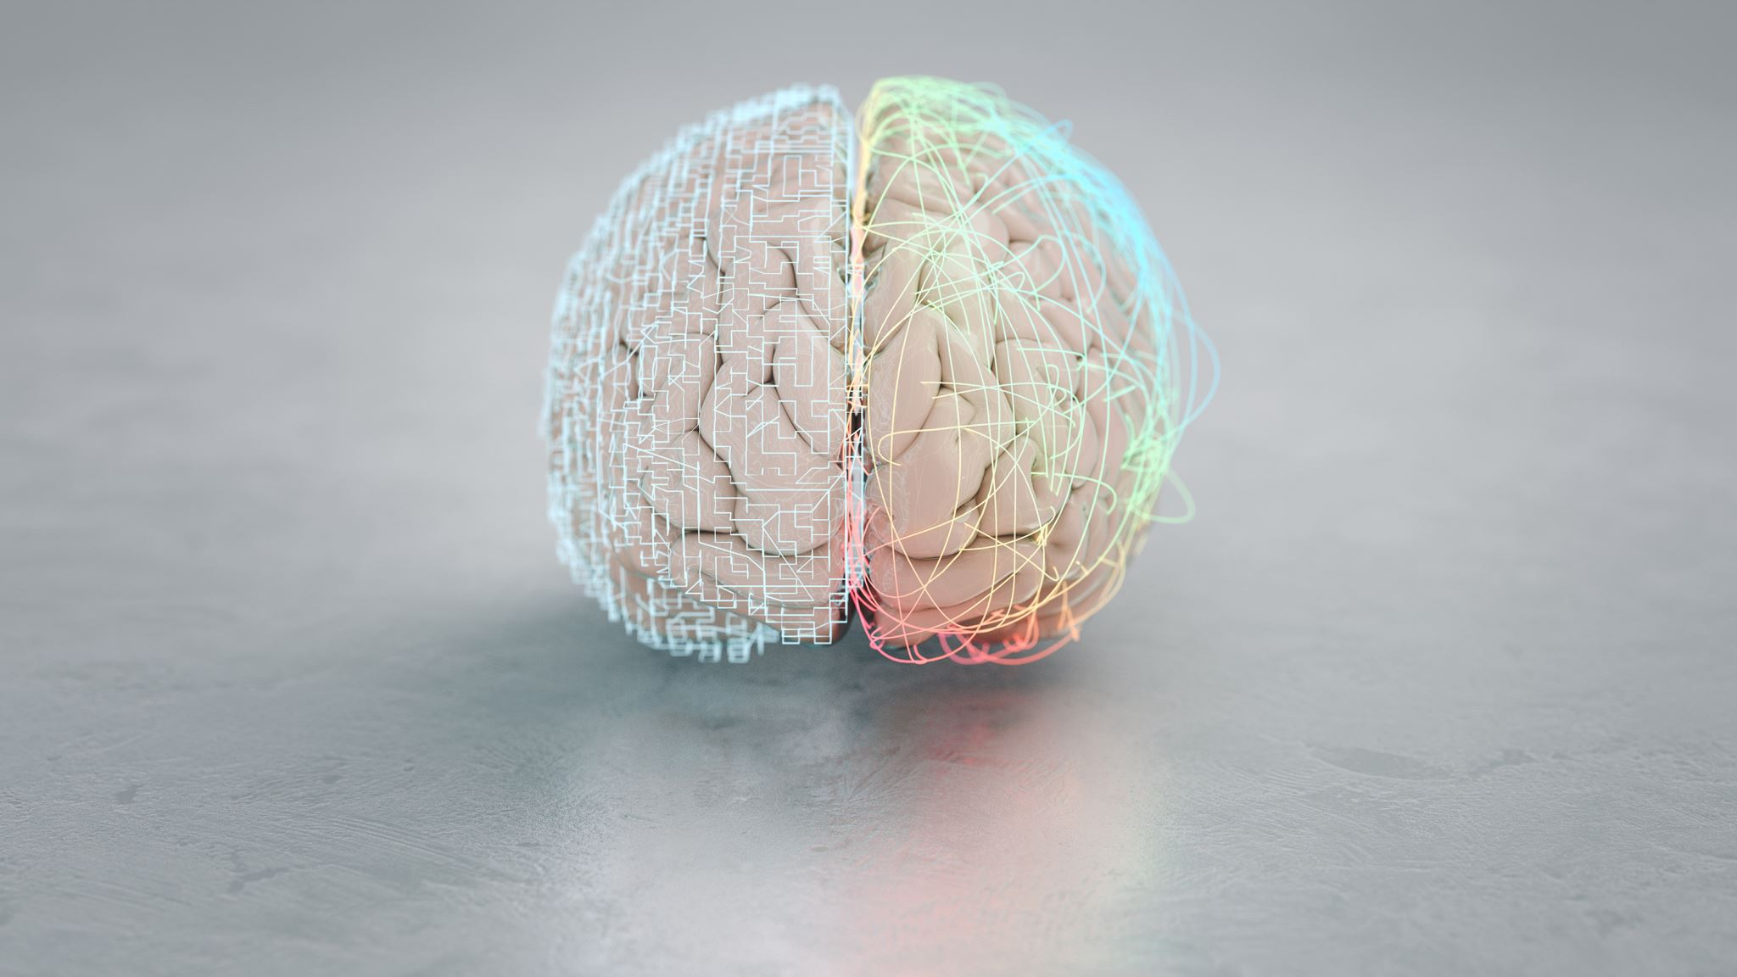
Same brain perceives different stimuli differently and Different brains perceive the same stimuli differently
Different parts of the brain get activated depending on the type of stimuli and the person’s individual response to it.
This difference is reflected in the EEG signals that help the models to identify the class of a new signal.
Depending on the unique features found in EEG signals of different stimuli, the model gets trained to identify those features during testing to classify the song or movie.
Variation in every individual’s brain perception results in the models learning features specific to the subject rather than the media. This fact is visible while doing the cross-subject evaluation.
This leads to the distribution shift or the out-of-distribution (OOD) generalization problem.

Slide 17
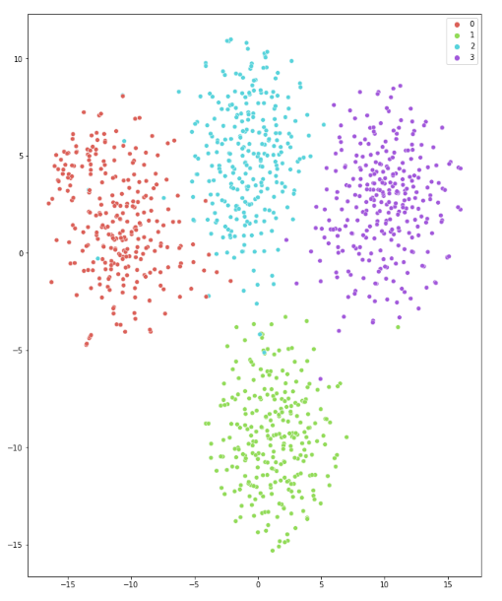
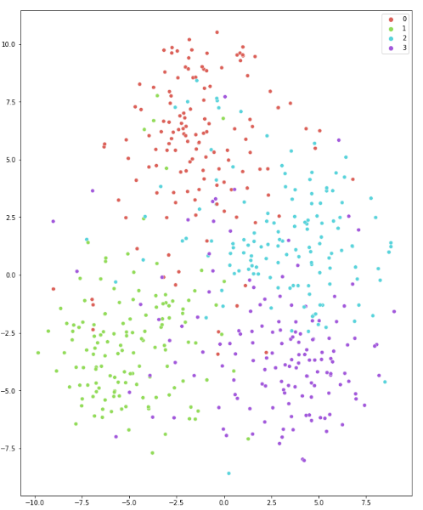
(a)
(b)
Fig 9: t-SNE plots for Song classification on a) train data, b) test data for within-subject evaluation

Slide 18
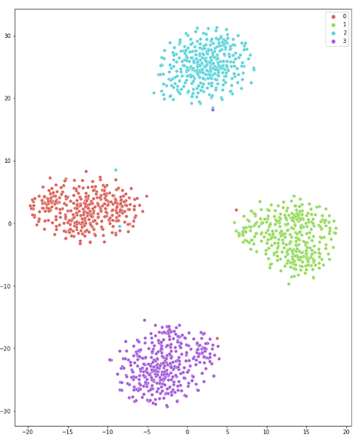
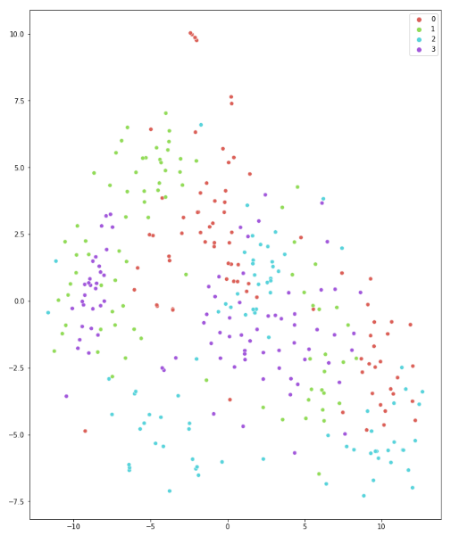
(a)
(b)
Fig 10: t-SNE plots for Song classification on a) train data, b) test data for cross-subject evaluation

Slide 19
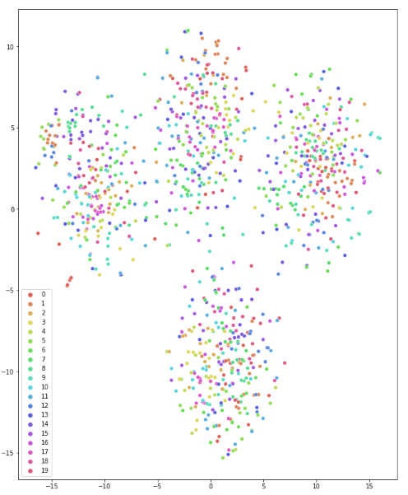
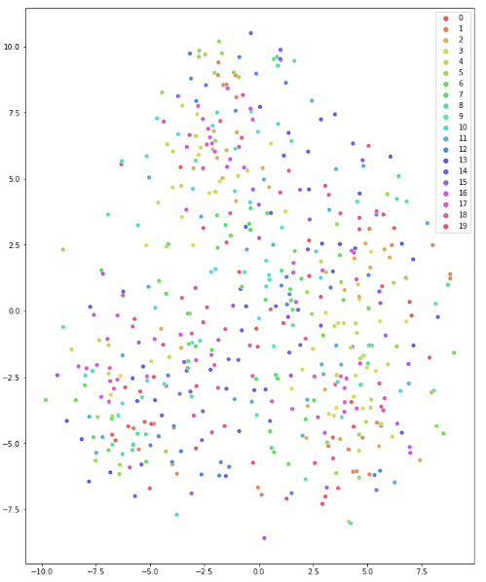
(a)
(b)
Fig 11: t-SNE plots for Subject classification on a) train data, b) test data for within-subject evaluation

Slide 20
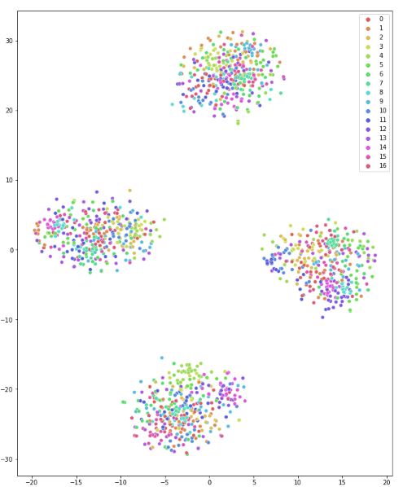
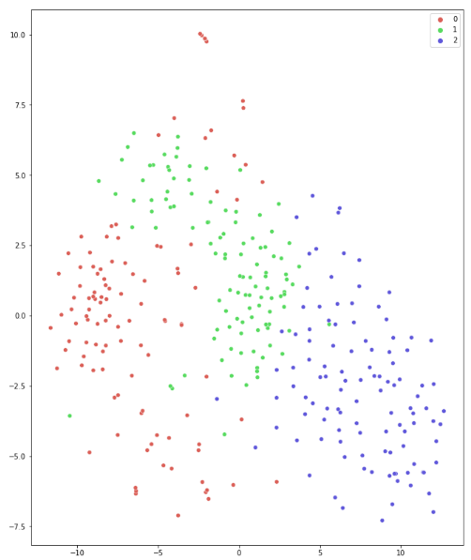
(a)
(b)
Fig 12: t-SNE plots for Subject classification on a) train data, b) test data for cross-subject evaluation

Slide 21
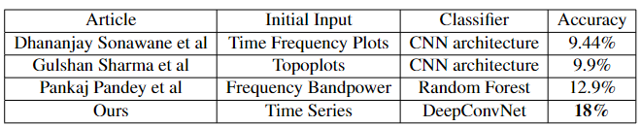
Why NMED-H reflects the highest accuracy
In the NMED-H dataset, a subject did not listen to a different version of the same song or another song of the same version.
The models have thus learned features not only unique to the media stimuli but to the subjects too.
Outperform performance on NMED-T Music Identification
Table 6: Comparision with other works on Cross-Subject Song Classification
Sonawane, D., Miyapuram, K. P., RS, B. & Lomas, D. J. GuessTheMusic: Song Identification from Electroencephalography response 2020.
Sharma, G., Pandey, P., Subramanian, R., Miyapuram, K. P. & Dhall, A. Neural Encoding of Songs is Modulated by Their Enjoyment 2022.
Pandey, P., Sharma, G., Miyapuram, K. P., Subramanian, R. & Lomas, D. Music Identification Using Brain Responses to Initial Snippets in ICASSP 2022 - 2022 IEEE International Conference on Acoustics, Speech and Signal Processing (ICASSP) (2022), 1246–1250

Slide 22
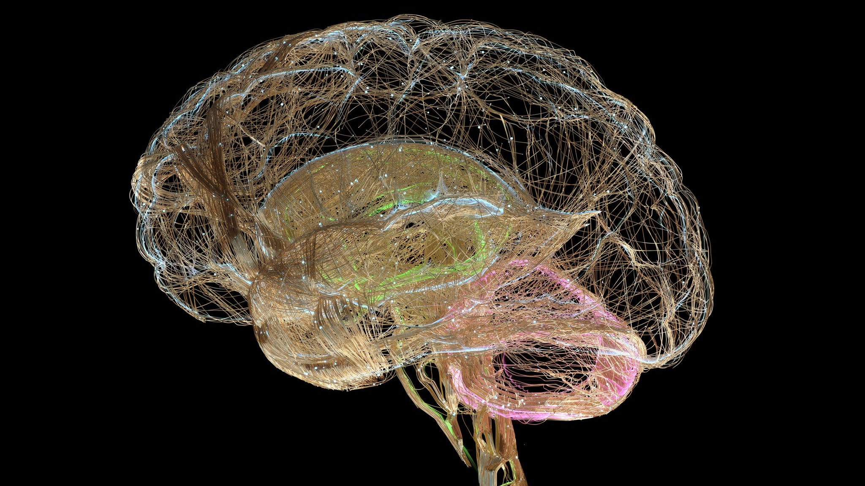
Discussion and Conclusion
We analyzed the EEG responses to media stimuli to identify patterns and features and investigate how these features influence our subjective experience of different media while pointing out the OOD generalization problem of the networks.
Future work could focus on improving the models’ ability to generalize to unseen data and incorporate larger datasets to improve model learning.
Linking EEG responses to human and machine perception has practical applications in fields such as music therapy, music production, and audio engineering.
Clinicians may be able to tailor treatments to individual patients’ needs by evaluating EEG data during different types of music therapy interventions.
Additionally, understanding how machines perceive and respond to music could help improve the design and development of music recommendation systems, music search engines, and other music-related applications.

Slide 23
References
Elahi, M., Ricci, F., Rubens, N.: A survey of active learning in collaborative filtering recommender systems. Computer Science Review 20, 29–50 (2016). https://doi.org/https://doi.org/10.1016/j.cosrev.2016.05.002, https://www.sciencedirect.com/science/article/pii/S1574013715300150
Geetha, G., Safa, M., Fancy, C., Saranya, D.: A hybrid approach using collaborative filtering and content based filtering for recommender system. Journal of Physics: Conference Series 1000(1), 012101 (apr 2018). https://doi.org/10.1088/1742- 6596/1000/1/012101, https://dx.doi.org/10.1088/1742-6596/1000/1/012101
Pandey, P., Tripathi, R., Miyapuram, K.P.: Classifying oscillatory brain activity associated with indian rasas using network metrics. Brain Informatics 9(1), 1–20 (2022)
Pandey, P., Swarnkar, R., Kakaria, S., Miyapuram, K.P.: Understanding consumer preferences for movie trailers from eeg using machine learning. arXiv preprint arXiv:2007.10756 (2020)
Su, J., Wen, Z., Lin, T., Guan, Y.: Learning disentangled behaviour patterns for wearable-based human activity recognition. Proceedings of the ACM on In- teractive, Mobile, Wearable and Ubiquitous Technologies 6(1), 1–19 (mar 2022). https://doi.org/10.1145/3517252, https://doi.org/10.1145%2F3517252
Pandey, P., Ahmad, N., Miyapuram, K.P., Lomas, D.: Predicting dominant beatfrequency from brain responses while listening to music. In: 2021 IEEE Inter- national Conference on Bioinformatics and Biomedicine (BIBM). pp. 3058–3064 (2021). https://doi.org/10.1109/BIBM52615.2021.9669750
Johri, R., Pandey, P., Miyapuram, K.P., Lomas, D.: Brain activity recognition using deep electroencephalography representation. In: 2023 IEEE Applied Sensing Conference (APSCON). pp. 1–3. IEEE (2023)
Pandey, P., Gupta, P., Miyapuram, K.P.: Brain connectivity based classification of meditation expertise. In: Brain Informatics: 14th International Conference, BI 2021, Virtual Event, September 17–19, 2021, Proceedings. pp. 89–98. Springer (2021)

Slide 24
References
Building the world’s most valuable brain data models, https://www.kernel.com/
Roy, Y., Banville, H., Albuquerque, I., Gramfort, A., Falk, T.H., Faubert, J.: Deep learning-based electroencephalography analysis: a systematic review - iopscience (Aug 2019), https://iopscience.iop.org/article/10.1088/1741-2552/ab260c
Transforming music into medicine, https://www.lucidtherapeutics.com/
Bedmutha, P., Pandey, P., Ahmed, N., Miyapuram, K.P., Lomas, D.: Canonical correlation analysis (cca) reveal neural entrainment for each song and similarity among genres (2022)
Chaudhary, S., Pandey, P., Miyapuram, K.P., Lomas, D.: Classifying eeg signals of mind-wandering across different styles of meditation. In: Brain Informatics: 15th International Conference, BI 2022, Padua, Italy, July 15–17, 2022, Proceedings. pp. 152–163. Springer (2022)
Duan, R.N., Zhu, J.Y., Lu, B.L.: Differential entropy feature for EEG-based emotion classification. In: 6th International IEEE/EMBS Conference on Neural Engineering (NER). pp. 81–84. IEEE (2013)
Tibor, S.R., Tobias, S.J., Josef, F.L.D., Martin, G., Katharina, E., Michael, T., Frank, H., Wolfram, B., Tonio, B.: Deep learning with con- volutional neural networks for eeg decoding and visualization. Human Brain Mapping 38(11), 5391–5420. https://doi.org/10.1002/hbm.23730, https://onlinelibrary.wiley.com/doi/abs/10.1002/hbm.23730
Zheng, W.L., Lu, B.L.: Investigating critical frequency bands and chan- nels for EEG-based emotion recognition with deep neural networks. IEEE Transactions on Autonomous Mental Development 7(3), 162–175 (2015). https://doi.org/10.1109/TAMD.2015.2431497

Slide 25
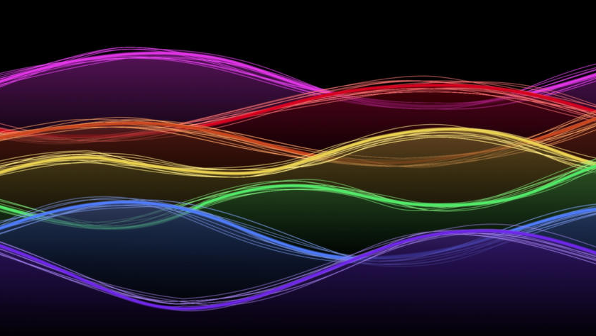
Thank You
This Photo by Unknown author is licensed under CC BY-SA.

